Slide 1
HNDIT 2312-Principles of Software Engineering
Week 4:Requirements Engineering

Slide 2
Topics covered
Functional and non-functional requirements
The software requirements document
Requirements specification
Requirements engineering processes
Requirements elicitation and analysis
Requirements validation
Requirements management

Slide 3
Requirements engineering
The process of establishing the services that the customer requires from a system and the constraints under which it operates and is developed.
The requirements themselves are the descriptions of the system services and constraints that are generated during the requirements engineering process

Slide 4
What is a requirement?
It may range from a high-level abstract statement of a service or of a system constraint to a detailed mathematical functional specification.

Slide 5
Types of requirement
User requirements
Statements in natural language plus diagrams of the services the system provides and its operational constraints. Written for customers.
System requirements
A structured document setting out detailed descriptions of the system’s functions, services and operational constraints. Defines what should be implemented so may be part of a contract between client and contractor.

Slide 6
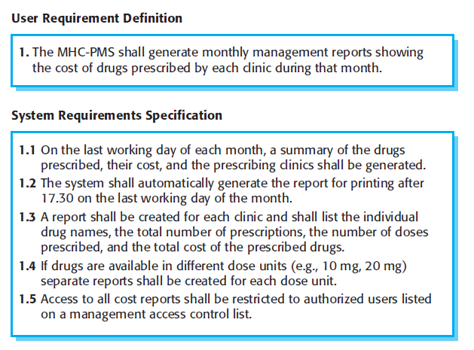
User and system requirements

Slide 7
Functional requirements
Describe functionality or system services.
Depend on the type of software, expected users and the type of system where the software is used.
Functional user requirements may be high-level statements of what the system should do.
Functional system requirements should describe the system services in detail.

Slide 8
Functional requirements
Example: F1 – Find Books
Input: the name of an author.
Output: details of any books by the author ,title, publisher, ISBN, etc.
Processing: search library catalogue for books by the specified author.

Slide 9
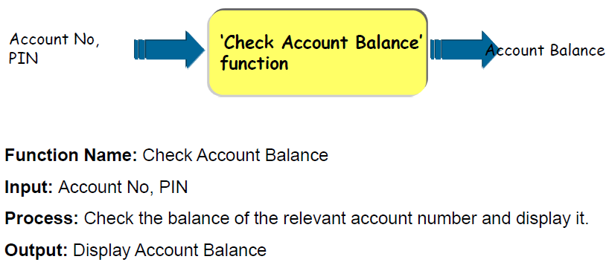
Functional Requirements-ATM System
Check Account Balance : Write as a Functional Requirement.

Slide 10
Non-functional requirements
These define system properties and constraints e.g. reliability, response time and storage requirements. Constraints are I/O device capability, system representations, etc.
Process requirements may also be specified mandating a particular IDE, programming language or development method.
Non-functional requirements may be more critical than functional requirements. If these are not met, the system may be useless.

Slide 11
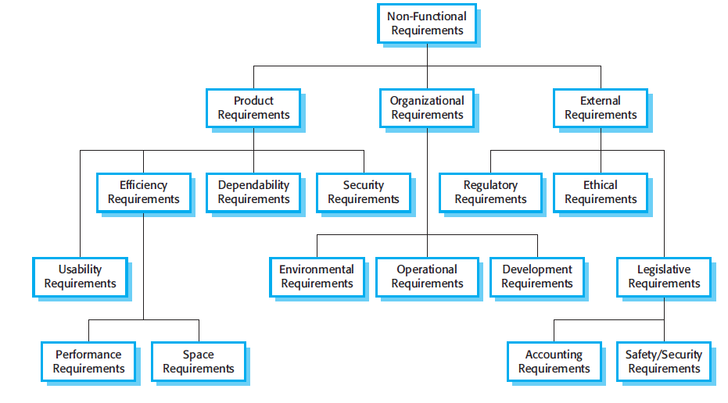
Types of nonfunctional requirement

Slide 12
Non-functional classifications
Product requirements
Requirements which specify that the delivered product must behave in a particular way e.g. execution speed, reliability, etc.
Organisational requirements
Requirements which are a consequence of organisational policies and procedures e.g. process standards used, implementation requirements, etc.
External requirements
Requirements which arise from factors which are external to the system and its development process e.g. interoperability requirements, legislative requirements, etc.

Slide 13
Domain requirements
The system’s operational domain imposes requirements on the system.
For example, a train control system has to take into account the braking characteristics in different weather conditions.
Domain requirements be new functional requirements, constraints on existing requirements or define specific computations.
If domain requirements are not satisfied, the system may be unworkable.

Slide 14
The software Requirements document(SRS)
The software requirements document is the official statement of what is required of the system developers.
Should include both a definition of user requirements and a specification of the system requirements.
It is NOT a design document. As far as possible, it should set of WHAT the system should do rather than HOW it should do it.

Slide 15
SRS Document
Introduction:
Background, system environment
Functional Requirements:
Numbered list of functions with inputs & outputs.
Non-Functional Requirements
System characteristics
External interfaces(e.g. user interface)
Constraints.
Verification(Acceptance)Criteria.

Slide 16
Requirements specification
The process of writing down the user and system requirements in a requirements document.
User requirements have to be understandable by end-users and customers who do not have a technical background.
System requirements are more detailed requirements and may include more technical information.

Slide 17
Ways of writing a system requirements specification
Notation | Description
Natural language | The requirements are written using numbered sentences in natural language. Each sentence should express one requirement.
Structured natural language | The requirements are written in natural language on a standard form or template. Each field provides information about an aspect of the requirement.
Design description languages | This approach uses a language like a programming language, but with more abstract features to specify the requirements by defining an operational model of the system. This approach is now rarely used although it can be useful for interface specifications.
Graphical notations | Graphical models, supplemented by text annotations, are used to define the functional requirements for the system; UML use case and sequence diagrams are commonly used.
Mathematical specifications | These notations are based on mathematical concepts such as finite-state machines or sets. Although these unambiguous specifications can reduce the ambiguity in a requirements document, most customers don’t understand a formal specification. They cannot check that it represents what they want and are reluctant to accept it as a system contract

Slide 18
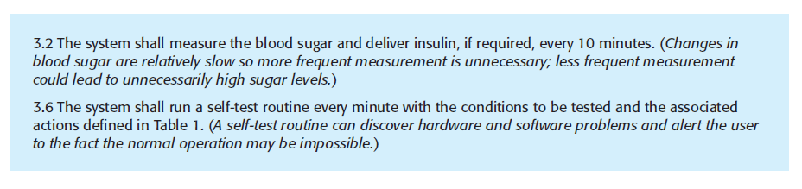
Natural language specification-Example

Slide 19
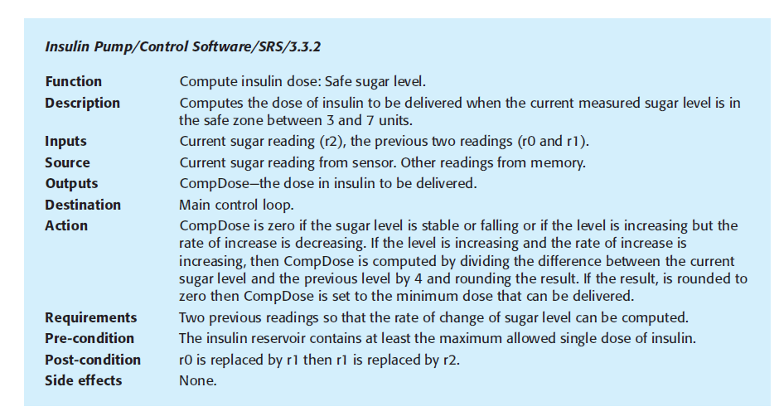
Structured specifications-Example

Slide 20
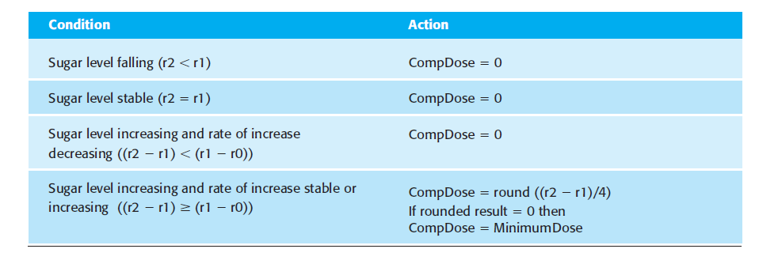
Tabular Specification-Decision Table

Slide 21
Requirements engineering processes
There are a number of generic activities common to all processes
Requirements elicitation;
Requirements analysis;
Requirements validation;
Requirements management.

Slide 22
Requirements elicitation and analysis
Sometimes called requirements elicitation or requirements discovery.
Involves technical staff working with customers to find out about the application domain, the services that the system should provide and the system’s operational constraints.
May involve end-users, managers, engineers involved in maintenance, domain experts, trade unions, etc. These are called stakeholders.

Slide 23
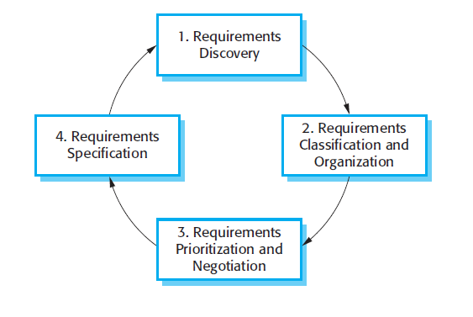
The requirements elicitation and analysis process

Slide 24
Problems of requirements elicitation
Stakeholders don’t know what they really want.
Stakeholders express requirements in their own terms.
Different stakeholders may have conflicting requirements.
Organisational and political factors may influence the system requirements.
The requirements change during the analysis process. New stakeholders may emerge and the business environment change.

Slide 25
Stakeholders
Stakeholders range from end-users of a system through managers to external stakeholders
For example, system stakeholders for the Hospital case study
Doctors
Patients
Nurses
Medical receptionists

Slide 26
Requirements discovery
The process of gathering information about the required and existing systems and distilling the user and system requirements from this information.
Interaction is with system stakeholders from managers to external regulators.
Systems normally have a range of stakeholders.

Slide 27
Interviewing
Formal or informal interviews with stakeholders are part of most RE processes.
Types of interview
Closed interviews based on pre-determined list of questions
Open interviews where various issues are explored with stakeholders.
Effective interviewing
Be open-minded, avoid pre-conceived ideas about the requirements and are willing to listen to stakeholders.
Prompt the interviewee to get discussions going using a springboard question, a requirements proposal, or by working together on a prototype system.

Slide 28
Scenarios
Scenarios are real-life examples of how a system can be used.
They should include
A description of the starting situation;
A description of the normal flow of events;
A description of what can go wrong;
Information about other concurrent activities;
A description of the state when the scenario finishes.

Slide 29
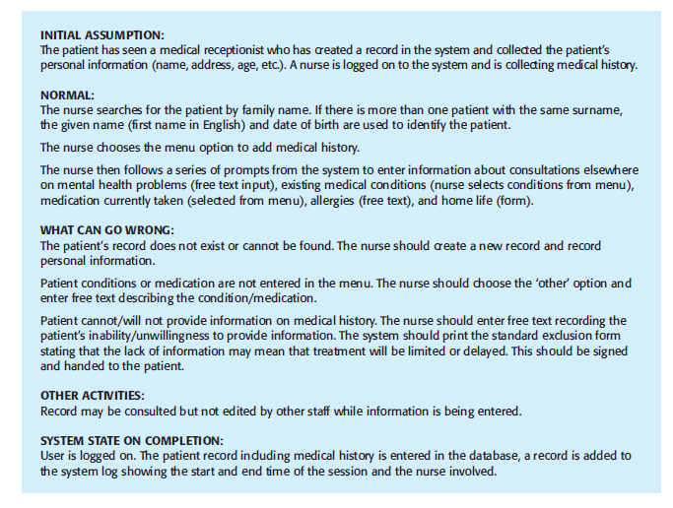
Scenario-Example

Slide 30
Use cases
Use-cases are a scenario based technique in the UML which identify the actors in an interaction and which describe the interaction itself.
A set of use cases should describe all possible interactions with the system.
High-level graphical model supplemented by more detailed tabular description (see Chapter 5).
Sequence diagrams may be used to add detail to use-cases by showing the sequence of event processing in the system.

Slide 31
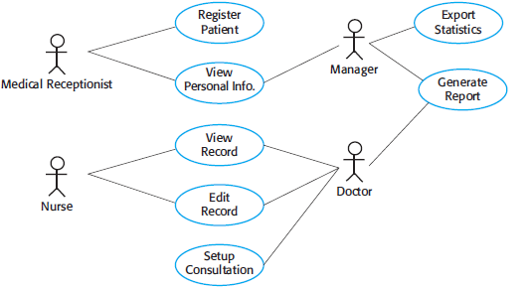
Use Case-Example

Slide 32
Requirements validation
Concerned with demonstrating that the requirements define the system that the customer really wants.
Requirements error costs are high so validation is very important
Fixing a requirements error after delivery may cost up to 100 times the cost of fixing an implementation error.

Slide 33
Requirements checking
Validity. Does the system provide the functions which best support the customer’s needs?
Consistency. Are there any requirements conflicts?
Completeness. Are all functions required by the customer included?
Realism. Can the requirements be implemented given available budget and technology
Verifiability. Can the requirements be checked?

Slide 34
Requirements validation techniques
Requirements reviews
Systematic manual analysis of the requirements.
Prototyping
Using an executable model of the system to check requirements. Covered in Chapter 2.
Test-case generation
Developing tests for requirements to check testability.

Slide 35
Requirements reviews
Regular reviews should be held while the requirements definition is being formulated.
Both client and contractor staff should be involved in reviews.
Reviews may be formal (with completed documents) or informal. Good communications between developers, customers and users can resolve problems at an early stage.

Slide 36
Review checks
Verifiability
Is the requirement realistically testable?
Comprehensibility
Is the requirement properly understood?
Traceability
Is the origin of the requirement clearly stated?
Adaptability
Can the requirement be changed without a large impact on other requirements?

Slide 37
Requirements management
Requirements management is the process of managing changing requirements during the requirements engineering process and system development.
New requirements emerge as a system is being developed and after it has gone into use.

Slide 38
Key points
Requirements for a software system set out what the system should do and define constraints on its operation and implementation.
Functional requirements are statements of the services that the system must provide or are descriptions of how some computations must be carried out.
Non-functional requirements often constrain the system being developed and the development process being used.

